Slide 1
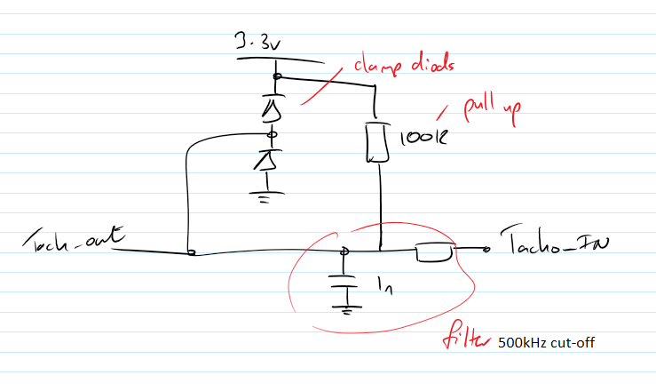
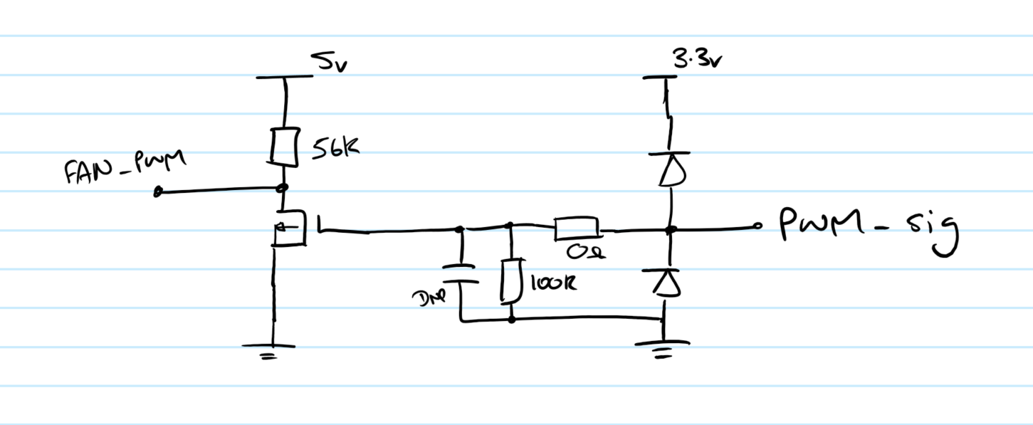
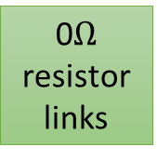
Follow Design from Dev Board
5V to 3.3v & 1.2v PSU
(see dev PCB for design)
MASTER PCB
USB Header
PWR
RST_OUT
Reset Circuit
TM4C129ENCPDT
USB
JTAG
UART_TX
JTAG Header
UART_RX
5V and GLV from Power PCB
JTAG Header
1MHz
bq76PL455A
(Slave)
5v
Galvanically isolated level shifter 5V (slave) to 3.3V (Master) (see datasheet for recommended use)
ISOW7842DWE
3.3v
JTAG:
P108 – P113
RST:
Warm + Cold
PWR
GND
AIR SENSE (+LED)
P009 – GIOA[2]
2 pin connector from auxiliary contactor, use pullup.
WAKEUP
WAKEUP
P002 – GIOA[0]
P132 – LINTX
CAN (MCP2561)
FAULT_N
FAULT_N
P131 – LINRX
P090 – DCAN1RX (J10_38)
TX
Check with Tom D. with CAN circuit design
UART_TX
P005 – GIOA[1]
P089 – DCAN1TX (J10_39)
RX
UART_RX
UART_RX
P039 - SCITX
BMS-OK RELAY (+LED)
UART_TX
P038 - SCIRX
TMS5701224
P126 – GIOB[0]
LE
Tacho Feedback
LED Driver (STP08CP05MTR)
7 Seg Hex Display
12V from Power PCB
CLK
P130 – MIBSPI1NCS[1]
SDI
P095 – MIBSPI1CLK
SD Card
http://elm-chan.org/docs/mmc/mmc_e.html
P093 – MIBSPI1SIMO
0$Ω$ resistor links
SCLK
P023 – N2HET1[1]
P094 – MIBSPI1SOMI
DI
P030 – N2HET1[2]
DO
P024 – N2HET1[3]
P105 – MIBSPI1NCS[0]
CS
14 PWM controlled 12V Fans
http://www.formfactors
.org/developer/specs/
REV1_2_Public.pdf
P036 – N2HET1[4]
Pull-up: CS, MOSI, MISO
Pull-down: CLK -------------------------------->>> Check site^ for details
P031 – N2HET1[5]
P033 – N2HET1[7]
Fan Tacho out
P106 – N2HET1[8]
Fan Tacho out
P035 – N2HET1[9]
Fan Tacho out
P118 – N2HET1[10]
Group traces by fan connector
Fan Tacho out
P006 – N2HET1[11]
For connector position on board talk to Aaron C. or Jake C.
Fan Tacho out
P124 – N2HET1[12]
Fan Tacho out
P125 – N2HET1[14]
Fan Tacho out
P041 – N2HET1[15]
P083 – AD1IN[8]/ADIN2[8]
Current Sense 1
Fan Tacho out
P139 – N2HET1[16]
P070 – AD1IN[9]/ADIN2[9]
Fan Tacho out
P072 – AD1IN[10]/ADIN2[10]
Current Sense 2
Fan Tacho out
P014 – EPWM1A
P075 – AD1IN[11]/ADIN2[11]
Fan Tacho out
P016 – EPWM1B
Ambient Temperature Thermistor 1
Fan Tacho out
P022 – EPWM2A
Fan Tacho out
P025 – EPWM2B
Fan Tacho out
P032 – EPWM4A
2x Fan PWM in
MOSFETs with Pull-ups
Put MOSFETs near connectors
P140 – EPWM6A
Ambient Temperature Thermistor 2
2x Fan PWM in
P141 – EPWM6B
2x Fan PWM in
2x Fan PWM in
2x Fan PWM in
2x Fan PWM in
2x Fan PWM in

Slide 2
Master PCB Components
Name | Description | Quantity | Manufacturer | Link | Part number
Connectors (communications) | IDC type (2.54 or 1.27mm pitch if needed for space) | ?
Connectors (Fans) | Fan 4 pin header | 14 | Molex or Generic
Fan | Static pressure 80x80x25mm max 4 wire with 25kHz PWM control | 14 per pack | MEGAFAN | http://uk.farnell.com/ebm-papst/8412n-2ghp/fan-pwm-control-80mm-12vdc/dp/1875270 Range: https://goo.gl/3ni9tn | 8412N/2GHP
Bidirectional Level shifter |  | 12 | NXP | http://uk.farnell.com/nxp/gtl2003pw-118/ic-level-translator-8-i-p-tssop/dp/2400477
Galvanically isolated level shifter | Digital Isolators High-Efficiency, Low-Emissions, Reinforced Digital Isolator With Integrated Power 16-SOIC -40 to 125 | 1 | TI | https://www.mouser.co.uk/ProductDetail/Texas-Instruments/ISOW7842DWE/?qs=sGAEpiMZZMssyD0wnx%2fymBptqwsKUoFZB4eOkTZIrnbkaqiP9XAw8A%3d%3d | ISOW7842DWE

